Slide 1
Outline
Learn about Virtualization
  Enforcing modularity on a single computer
  Virtual Processors -Threads
  Virtual Memory address spaces
  Virtual Links – Bounded buffers
Implement virtual link
Suggested reading
  5.1, 5.2
1

Slide 2
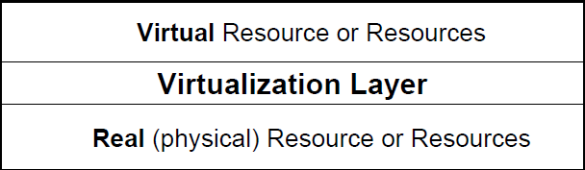
Virtualization
Widely used term involving a layer of indirection top of some abstraction

Slide 3
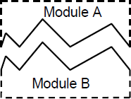
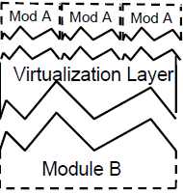
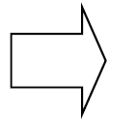
Virtualization -Multiplexing
Examples:
  Thread: 1 CPU looks like N CPUs
  Virtual Memory: 1 memory looks like N memories
  Virtual Circuit: 1 channel looks like N channels
  Virtual Machine: 1 machine looks line N machines
    Virtual Links – Bounded buffers

Slide 5
Virtualization -Aggregation
Module A
Module B
Module A
Virtualization Layer
Mod B
Mod B
Mod B
Examples:
  RAID disks: N disks look like one disk
  Channel Bounding: N channels look like one
  Compute side: GPUs?

Slide 6
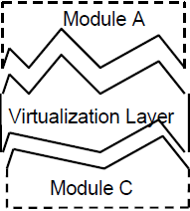

Virtualization -Emulation
Examples:
  RAM Disk: Make a RAM memory act like a very fast disk
  Apple’s Rosetta Technology: Make a x86 CPU look like a Power PC CPU
  Virtual Machines: Virtual card punches, virtual card readers, virtual networks

Slide 7
Using Virtualization for Enforced Modularity
Major abstractions:
  Memory
    Virtual memory
  Interpreter
    Thread
  Communication
    Bounded buffer virtual link
By Use Operating System abstractions

Slide 8
Thread of Execution
each module ------- its own interpreter
  (virtual)
Thread of execution
  Program counter
    x86 eip
  Environment
    x86: eax, ebx, ecx, edx, fp regs, memory (stack, heap)

Slide 9
Thread of Execution (2)
OS needs to:
  Suspend one thread
  Resume it later

Slide 10
Memory modularity enforcement
If no virtual memory
  Then no protection
Bad things happen
Physical memory name space
0x9000
0x7000
0x4000
0x3000
0x0000
OS
gcc
disk image access
emacs

Slide 11
Virtual Memory Address Spaces
Enforced Modularity
  Each module only names (refer) it’s own physical memory
2^{n}
0
2^{n}
0
Module B
Module A
Operating System
Module

Slide 12
Virtual Communication Links
Boundd buffer
2^{n}
0
2^{n}
0
Module A
Module B
OS
SEND(buffer, message)
Message ← RECEIVE(buffer)

Slide 13
Send Implementation
1 shared structure buffer // A shared bounded buffer
2 { message instance message [ N ] // with a maximum of N messages
3 Integer in initially 0 // Counts number of messages put in the buffer
4 integer out initially 0 } // Counts number of messages taken out of the buffer
5
procedure SEND (buffer reference p, message instance msg)
6 while p.in – p.out = N do nothing ；// If buffer is full, wait for room
7 p.message[p.in modulo N] ← msg // Put message in the buffer
8 p.in ← p.in + 1 // Increment in

Slide 14
Receive Implementation
9 procedure RECEIVE (buffer reference p)
10 while p.in = p.out do nothing // If buffer is empty, wait for message
11 msg ← p.message[p.out modulo N] // Copy item out of buffer
12 p.out ← p.out + 1 // Increment out
return msg // Return message to receiver

Slide 15
Send/Receive Implementation Assumptions
Single producer & Single consumer
Each on own CPU
in and out don’t overflow （how about 64 bit ?）
read/write coherence
in and out before-or-after atomicity
The result of executing a statement becomes visible to other threads in program order
  Compilers cannot optimize it

Slide 16
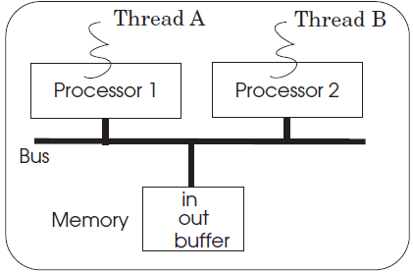
Race conditions
Sender A, sender B
They are Asynchronous interpreters

Slide 17
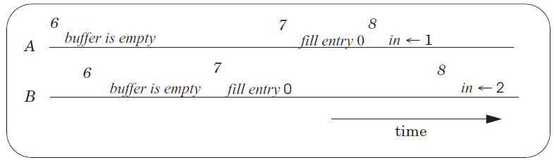
Race conditions ---2 senders
B’s item lost
Race condition:
  timing dependent
  ( Whether it happens depends on how threads scheduled )

Slide 18
Race conditions ─ Hard to Control
Schedules dependent
Small timing changes
      Get different result
Debugging
      change timing
  Heisenbugs (Heisenberg)

Slide 19


Race Condition if two writes
p.in = p.in + 1
in = 0
time
Thread1
Thread2
mov in, %eax(0)
add $0x1,%eax mov in, %eax(0)
mov %eax, in (1) add $0x1, %eax
mov %eax, in (1)
in = 1
Debugging can be extremely difficult

Slide 20
Before-or-After Atomicity
Code assumes that when the producer does:
    p.in = p.in + 1
and the consumer reads in:
    while (p.in == p.out) do nothing； // Spin
will receive the value of in before or after the assignment
Most machines have atomicity when the variable size is less than or equal to the memory width
before or after

Slide 21
Before-or-After Atomicity
volatile int in; (32 bits)
Works on 32 and 64 bit machines
    Mov in, %eax
    add $0x1, %eax
    mov %eax, in

Slide 22
Before-or-After Atomicity
volatile long long int in;
Works only on 64bit machines, not 32bit
    mov in, %eax
    mov in+4, %edx
    add $0x1, %eax
    adc $0x0, %edx
    mov %eax, in
    mov %edx, in+4
Then，1 writer and 1 reader is not safe

Slide 23
Using Locks
Developers’ burden
  figure out the problem
acquire/release of locks
  Nothing is automatic
  Forget in one place， and you have race conditions
  Forget to release a lock
  try to acquire it twice, and you have likely have a deadlock

Slide 24
Send/Receive with Locks
1 shared structure buffer // A shared bounded buffer
2 message instance message[N] // with a maximum of N messages
3 long integer in initially 0 // Counts number of messages put in the buffer
4 long integer out initially 0 // Counts number of messages taken out of the buffer
5 lock instance buffer_lock initially UNLOCKED // Lock to order sender and receiver

Slide 25
Send/Receive with Locks
6 procedure SEND (buffer reference p, message instance msg)
7 ACQUIRE (p.buffer_lock)
8 while p.in – p.out = N do { // Wait
9 RELEASE (p.buffer_lock) // RECEIVER may get lock
ACQUIRE (p.buffer_lock)
}
11 p.message[p.in modulo N] ← msg // Put message
12 p.in ← p.in + 1 // Increment in
13 RELEASE (p.buffer_lock)

Slide 26
Send/Receive with Locks
14 procedure RECEIVE (buffer reference p)
15 ACQUIRE (p.buffer_lock)
16 while p.in = p.out do // Wait until ..
17 RELEASE (p.buffer_lock) // While waiting release lock
18 ACQUIRE (p.buffer_lock)
19 msg ← p.message[p.out modulo N] // Copy item out of buffer
20 p.out ← p.out + 1 // Increment out
21 RELEASE (p.buffer_lock)
22 return msg

Slide 27
Using Locks
Developers’ burden
  figure out the problem
acquire/release of locks
  Nothing is automatic
  Forget in one place， and you have race conditions
  Forget to release a lock
  try to acquire it twice, and you have likely have a deadlock

Slide 28
Lock Granularity
5 share data
1 lock V.s. 5 locks
5 locks lead to complexity

Slide 29
Lock Granularity
Coarse-grain locking
  + Simpler, easier to reason about
  - Less concurrency
Fine-grain locking
  + High amount of concurrency
  - More complex
  - Overhead for locks

Slide 30
Simple example of granularity
Allocate a single lock and acquire the lock every time you enter the subsystem
and release it when you leave the subsystem
  Advantage: Simple. As long as subsystem doesn’t call into itself recursively everything is fine
  Disadvantage: No concurrency

Slide 31
Simple example of granularity
OK, if a subsystem doesn’t need concurrency while other parts of the system does
  Example: Many large software projects
    Many modern operating systems (Example: Unix/Linux, NT)

Slide 32
One-writer principle
If each variable has only one writer, coordination becomes easier
Concurrency and read-only data is easy
Guide: Make as much data as you can have only a single writer
  privatization --Make data private to a thread
    Allocate on thread stack
    Array indexed by thread_id()
      E.g. privateData[thread_id()]...
Focus locking scheme on data shared read/write

Slide 33
Simple locking discipline
Allocate a lock for every shared variable
Acquire the lock of a variable before every piece of code that access the variable
  Release lock when you are done
Locking at modular boundaries might work
  Also might not

Slide 34


Slide 35
Deadlock
An undesirable interaction among a group of threads in which
  each thread is waiting for some other thread in the group to make progress
Tread A Tread B
acquire(L1) acquire(L2)
acquire(L2) acquire(L1)

Slide 36
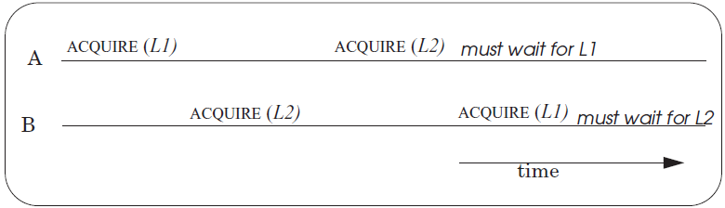

Deadlock
Thread A cannot make forward progress, since thread B has acquired L2,
Thread B cannot make forward progress, because thread A has acquired L1.
The threads are in a deadly embrace.

Slide 37
Deadlock
Tread A Tread B
acquire(L1) acquire(L1)
acquire(L2) acquire(L2)
then no deadlock could have occurred.
! !! Again, small changes
  can result in good or bad behavior

Slide 38
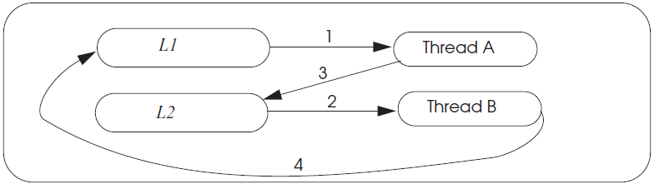
Deadlock wait-for Graph

Slide 39
Deadlock wait-for Graph
The nodes in a wait-for graph are
  locks and threads
When a thread acquires a lock, it inserts
  a directed edge from the
  lock node to the thread node
When a thread must wait for a lock, it inserts
  another directed edge from the thread node to the lock node

Slide 40
Deadlock theory
Four necessary and sufficient conditions for deadlock
Limited access
  Resource can only be shared with finite users.
No preemption
  once resource granted, cannot be taken away.
Multiple independent requests (hold and wait)
  don’t ask all at once (wait for next resource while holding current one)
Cycle in wait for graph

Slide 41
Livelock
An interaction among a group of threads in which
  each thread is repeatedly performing some operations
  but never able to complete the whole sequence of operations

Slide 42


Slide 43
Implementing with problem
1 structure lock
2 integer state
3
4 procedure FAULTY_ACQUIRE (lock reference L)
5 while L.state = LOCKED do nothing ; // spin until L is UNLOCKED
6 L.state ← LOCKED // the while test failed, got the lock
7
8 procedure RELEASE (lock reference L)
9 L.state ← UNLOCKED

Slide 44
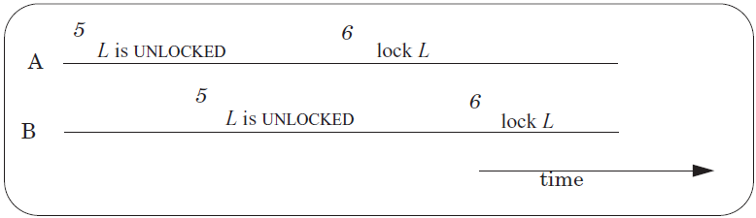
Implementing ACQUIRE and RELEASE

Slide 45
Bootstrapping
The ACQUIRE is multi-step
  must ensure
  ACQUIRE itself is a before-or-after action
Then we can use ACQUIRE

Slide 46
Bootstrapping
Resembles an inductive proof
a general problem ----→ much-narrower particular version of the same problem
  making multi-step operations on shared variables before-or-after actions
  making an operation on a single shared lock a before-or-after action

Slide 47
Bootstrapping
Solve the narrow problem by specialized method
  might work for only that case
  it takes advantage of the specific situation
The general solution then consists of two parts:
  a method for solving the special case
  a method for reducing the general problem to the special case

Slide 48
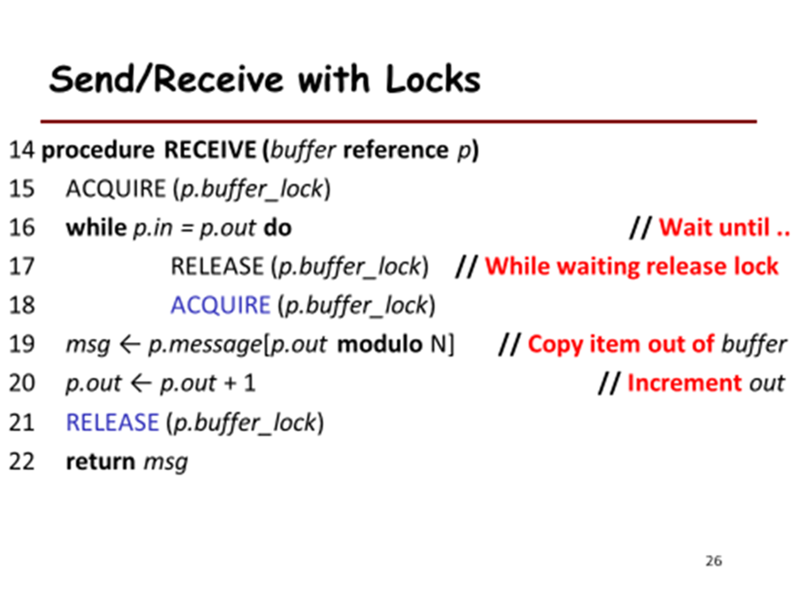
Bootstrapping
Solve the narrow problem by specialized method
  might work for only that case
  it takes advantage of the specific situation
The general solution then consists of two parts:
  a method for solving the special case
  a method for reducing the general problem to the special case

Slide 49
Bootstrapping(In the case of ACQUIRE)
The solution
  Atomic instruction
  Genius(Ye)’s programming

Slide 50
READ and SET
1 procedure RSM (reference mem) // RSM memory location mem
2 do atomic
3 r ← mem // Load value stored at mem into r
4 mem ← LOCKED // Store LOCKED into memory location mem
5 return r

Slide 51
Implementing ACQUIRE and RELEASE
1 procedure ACQUIRE (lock reference L)
2 R1 ← RSM (L.state) // read and set lock L
3 while R1 = = LOCKED do // was it already locked?
4 R1 ← RSM (L.state) // yes, do it again, till we see it wasn’t
5
6 procedure RELEASE (lock reference L)
7 L.state ← UNLOCKED

Slide 52
Using the One-Writer Principle
shared boolean flag[N] // one boolean per thread
1 procedure RSM (lock reference L) // set lock L and return old value
2 do forever
3 flag[me] ←TRUE // warn other threads
4 if ANYONE_ELSE_INTERESTED (me) then// is another thread warning us?
5 flag[me] ← FALSE // yes, reset my warning, try again
6 else
7 R ← L.state // set R to value of lock
8 L.state ← LOCKED // and set the lock
9 flag[me] ← FALSE
10 return R

Slide 53
Using the One-Writer Principle
11
12 procedure ANYONE_ELSE_INTERESTED (me)
// is another thread updating L?
13 for i from 0 to N–1 do
14 if i ≠ me and flag[i] = TRUE then return TRUE
15 return FALSE

Slide 54
Assumptions
The existence of a bus arbiter
  LOAD or STORE is
  before-or-after
Each entry of the shared array is
  in its own memory cell
  the memory provides read/write coherence for memory cells
The instructions execute in program order
（ NO reorder）

Slide 55
Correctness
Two threads
  thread A and Thread B
Three cases
  A sets flag[A] before B sets flag[B]
  B sets flag[B] before A sets flag[A]
  A sets flag[A] and B sets flag[B] before either of them
    Rest and try again
    Livelock
    Random backoff

Slide 56

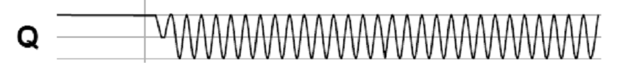
Bus arbiter problem (skip)
A:
Arbiter
S:
A:
B:
Clock:
B:
S:
Clock:
t_{E}
Two async inputs (A, B), one sync output
  Choose between two asynchronous input
If inputs are closely spaced,
  output may be oscillating
  Waiting longer only reduce the probability of oscillating

